Slide 1

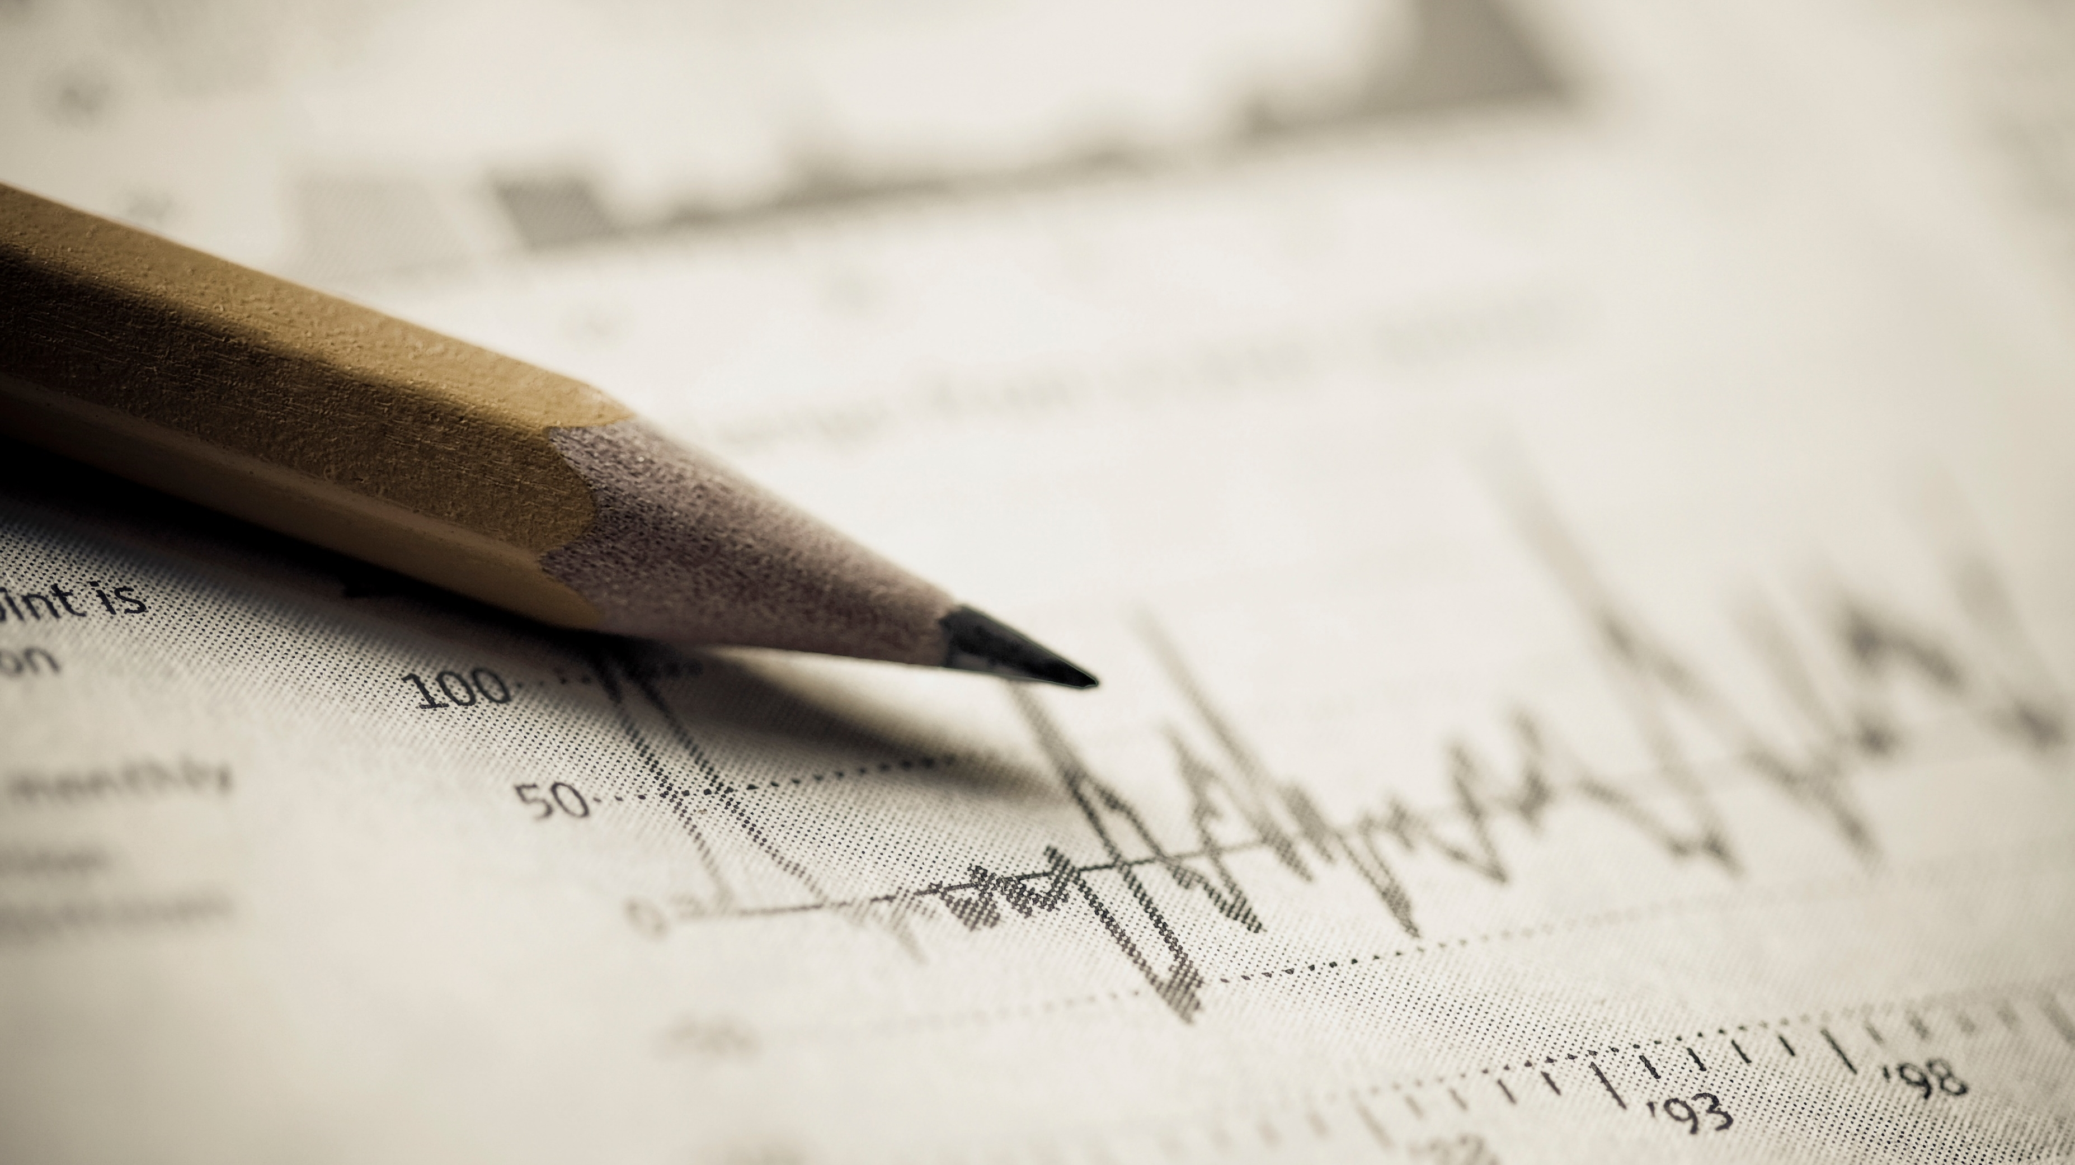
Arran Siu

Slide 2
Major Functions
Login | TRADE | Market information | Hall of fame
Allow user to sign up | Users are given tokens equivalent to US$1,000,000 | Tradable cryptocurrency prices are updated using scheduler | Display top 5 players with highest balance
Use session to secure user data | User can use these virtual tokens to buy or sell selected cryptocurrencies | Get historical price data | Top 3 players are awarded with medal
Password is hashed in database | Price quotes are in real-time | Display candle chart | Ranking are calculated with live data

Slide 3
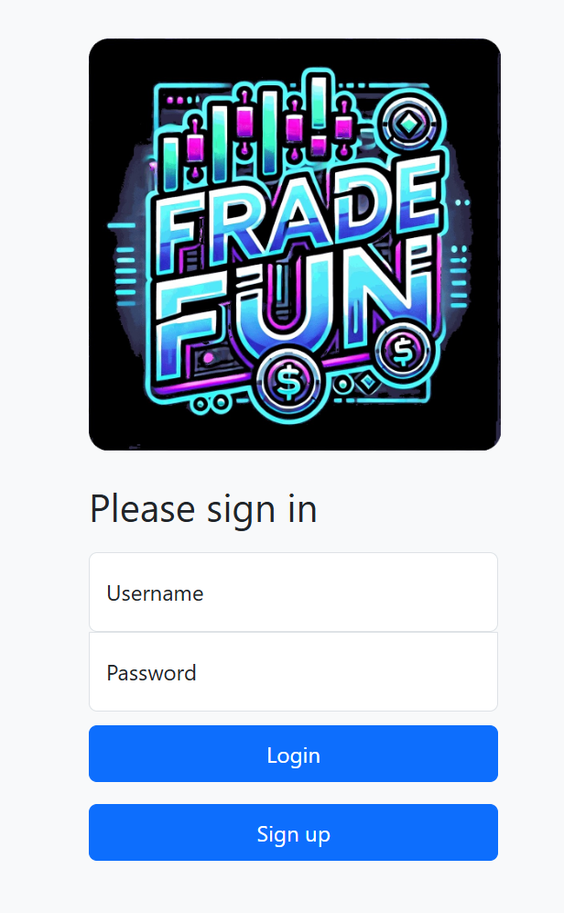
Login

Slide 4
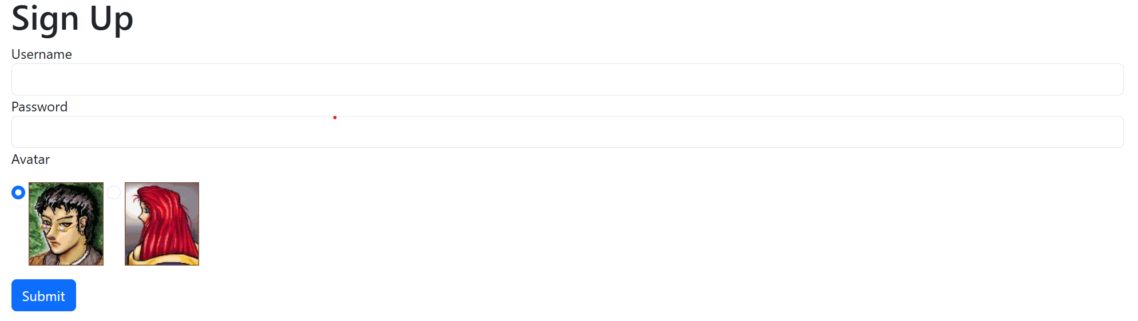

Slide 5
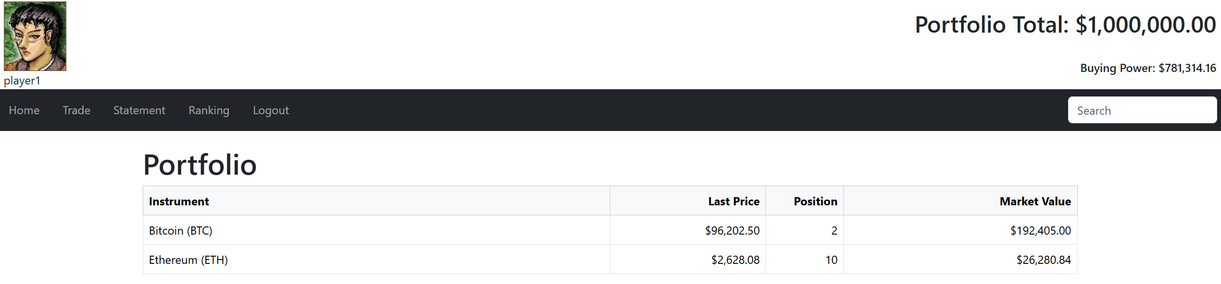
View Portfolio

Slide 6
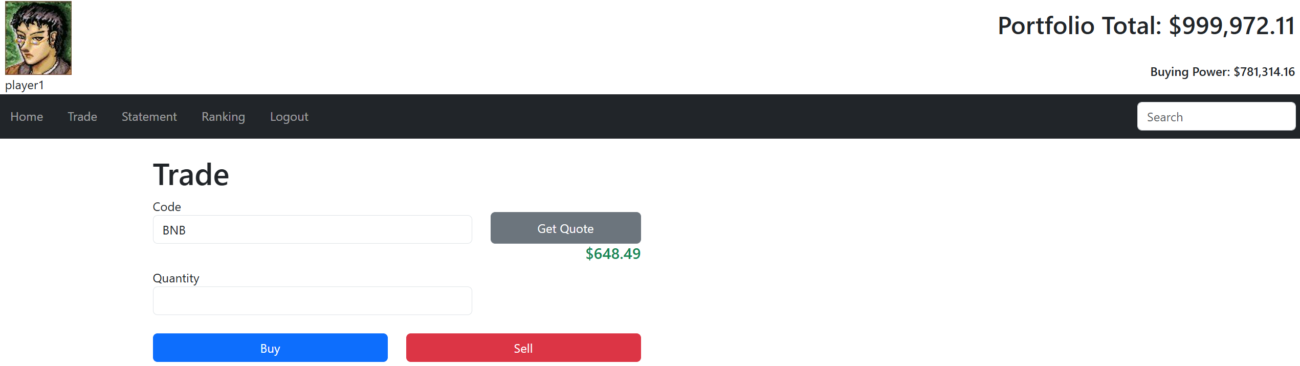
Trade

Slide 7
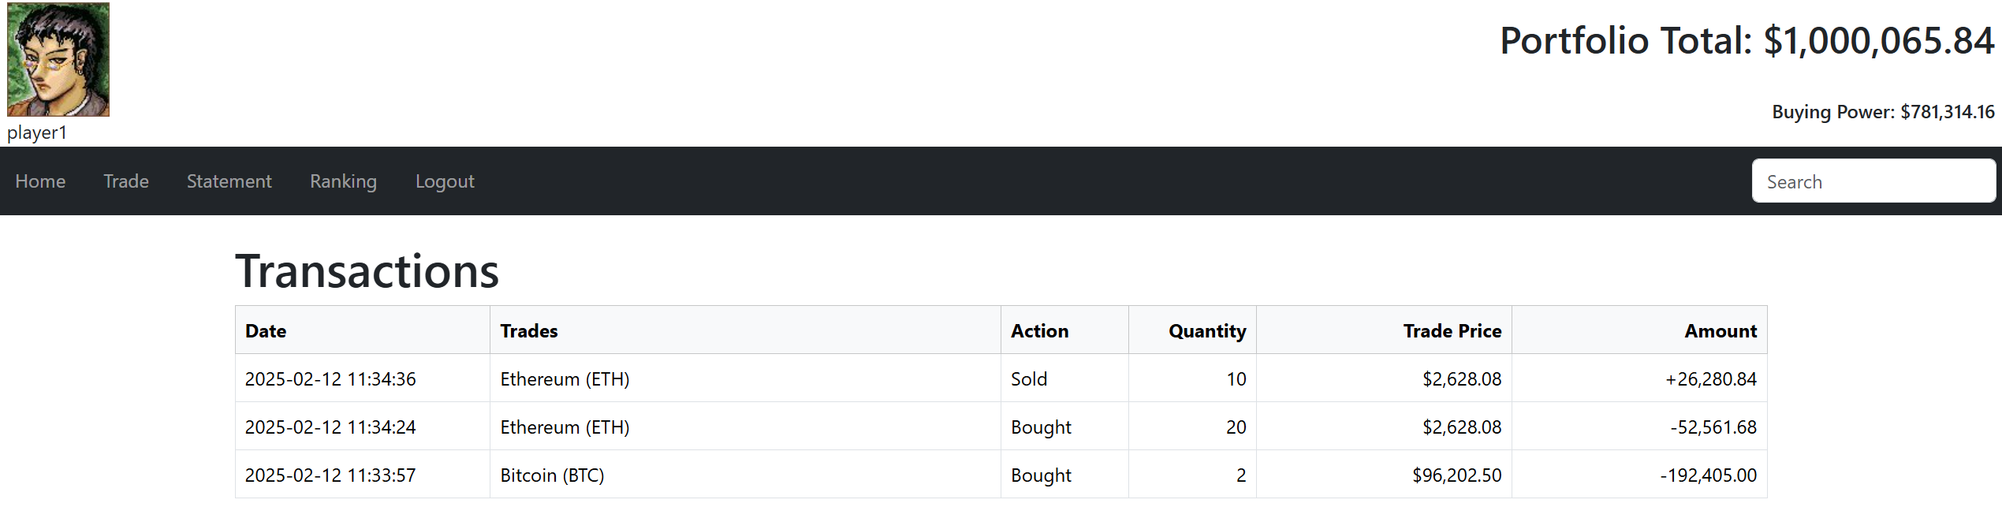
View Transactions

Slide 8
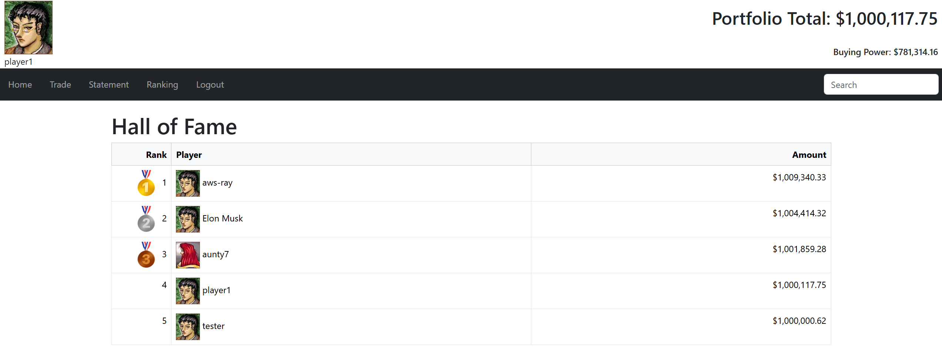
Hall of Fame

Slide 9
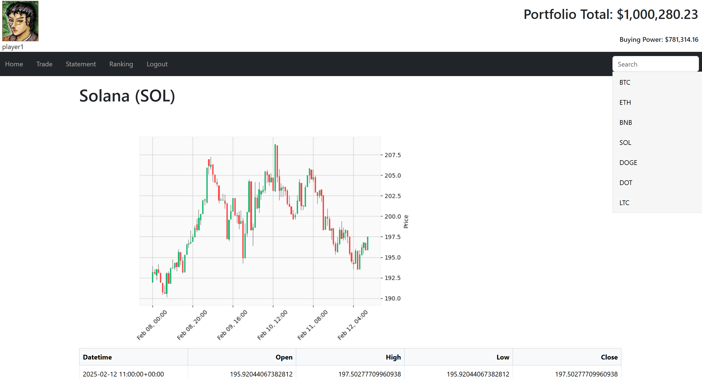
Market Information

Slide 10
Database Design
USER
USERID (pk) | TEXT
PASSWD | TEXT
CREATDT | TIMESTAMP
TOKEN | NUMERIC
AVATAR | TEXT
PORTFOLIO
USERID (pk1) | TEXT
CODE(pk2) | TEXT
QTY | INTEGER
TRANS
TRANSID (pk) | INTEGER
USERID | TEXT
CODE | TEXT
QTY | INTEGER
PRICE | NUMERIC
CREATEDT | TIMESTAMP
CRYPTO
CODE (pk) | TEXT
CRYPTO_NAME | TEXT
TICKER | TEXT

Slide 11
Class Design
market
-info:pandas
+update()
+getTicker(code)
+getFullname(code)
+getQuote(code)
+getHistory(code, period, interval)
user
-userid:string
-token:float
-avatar:string
+getPortfolio(market)
+getBalance(market)
+buy(code, qty, market)
+sell(code, qty, market)
+getTransactions()

Slide 12
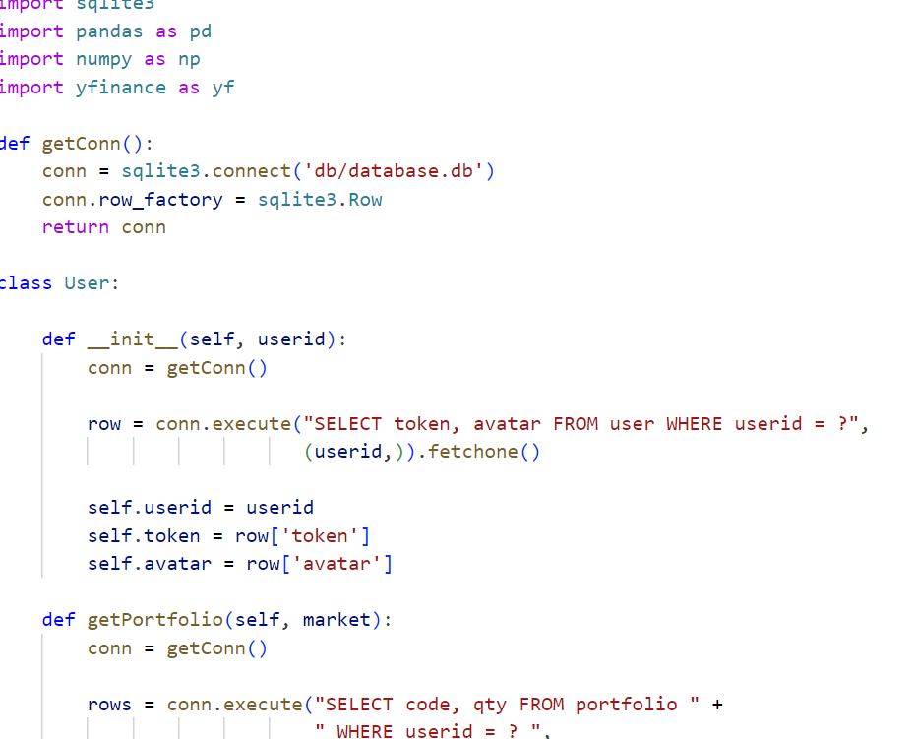
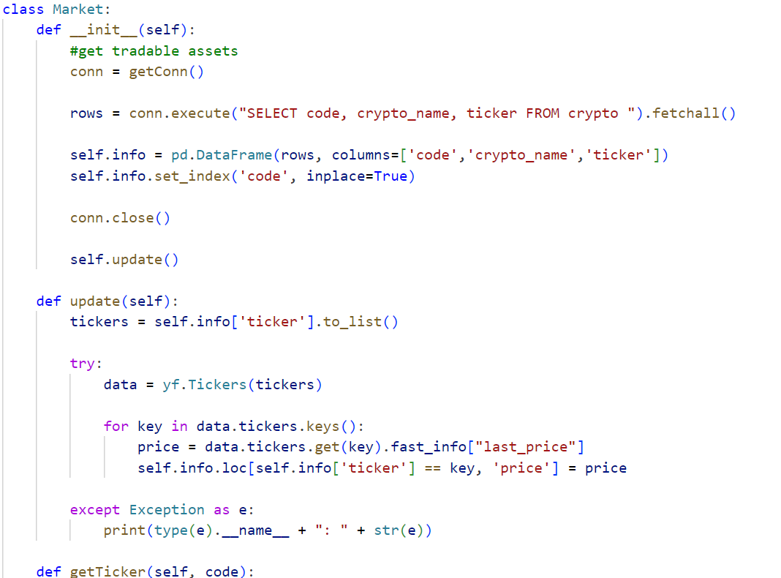
Tradefun.py

Slide 13
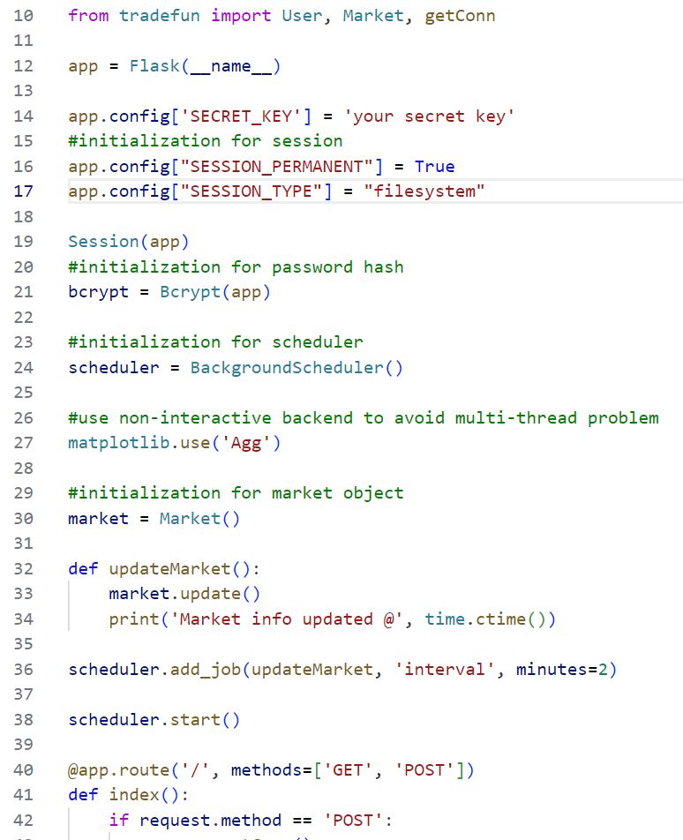
App.py

Slide 14
Demo / Q & A
Thank You

